Slide 1
Chapter 4: Data Movement Instructions

Slide 2
Introduction
This chapter concentrates on the data movement instructions.
The data movement instructions include MOV, MOVSX, MOVZX, PUSH, POP, BSWAP, XCHG, XLAT, IN, OUT, LEA, LDS, LES, LFS, LGS, LSS, LAHF, SAHF.
String instructions: MOVS, LODS, STOS, INS, and OUTS.

Slide 3
Chapter Objectives
Upon completion of this chapter, you will be able to:
Explain the operation of each data movement instruction with applicable addressing modes.
Explain the purposes of the assembly language pseudo-operations and key words such as ALIGN, ASSUME, DB, DD, DW, END, ENDS, ENDP, EQU, .MODEL, OFFSET, ORG, PROC, PTR, SEGMENT, USEI6, USE32, and USES.

Slide 4
Chapter Objectives
(cont.)
Upon completion of this chapter, you will be able to:
Select the appropriate assembly language instruction to accomplish a specific data movement task.
Determine the symbolic opcode, source, destination, and addressing mode for a hexadecimal machine language instruction.
Use the assembler to set up a data segment, stack segment, and code segment.

Slide 5
Chapter Objectives
(cont.)
Upon completion of this chapter, you will be able to:
Show how to set up a procedure using PROC and ENDP.
Explain the difference between memory models and full-segment definitions for the MASM assembler.
Use the Visual online assembler to perform data movement tasks.

Slide 6
4–1 MOV Revisited
In this chapter, the MOV instruction introduces machine language instructions available with various addressing modes and instructions.
It may be necessary to interpret machine language programs generated by an assembler.
Occasionally, machine language patches are made by using the DEBUG program available
with DOS and Visual for Windows.

Slide 7
Machine Language
Native binary code microprocessor uses as its instructions to control its operation.
  instructions vary in length from 1 to 13 bytes
Over 100,000 variations of machine language instructions.
  there is no complete list of these variations
Some bits in a machine language instruction are given; remaining bits are determined for each variation of the instruction.

Slide 8
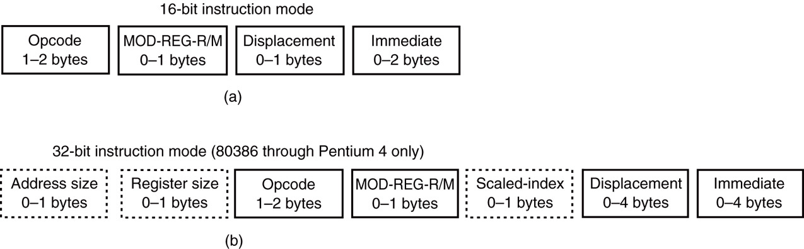
Figure 4–1 The formats of the 8086–Core2 instructions. (a) The 16-bit form and (b) the 32-bit form.
  80386 and above assume all instructions are 16-bit mode instructions when the machine is operated in the real mode (DOS).
  in protected mode (Windows), the upper byte of the descriptor contains the D-bit that selects either the 16- or 32-bit instruction mode

Slide 9
The Opcode
Selects the operation (addition, subtraction, etc.,) performed by the microprocessor.
  either 1 or 2 bytes long for most instructions
Figure 4–2 illustrates the general form of the first opcode byte of many instructions.
  first 6 bits of the first byte are the binary opcode
  remaining 2 bits indicate the direction (D) of the data flow, and indicate whether the data are a
  byte or a word (W)

Slide 10
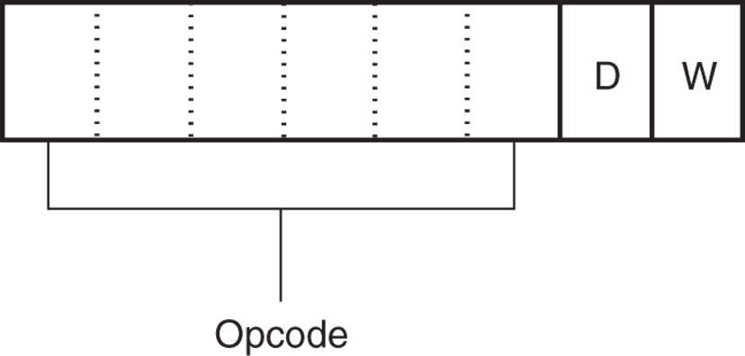
Figure 4–2 Byte 1 of many machine language instructions, showing the position of the D- and W-bits.

Slide 11
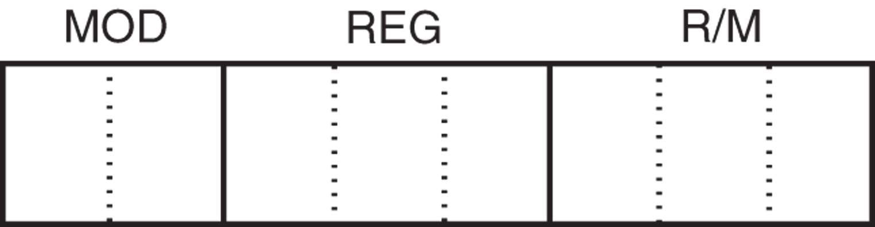
Figure 4–3 Byte 2 of many machine language instructions, showing the position of the MOD, REG, and R/M fields.

Slide 12
MOD Field
Specifies addressing mode (MOD) and whether a displacement is present with the selected type.
  If MOD field contains an 11, it selects the register-addressing mode
  Register addressing specifies a register instead
  of a memory location, using the R/M field
If the MOD field contains a 00, 01, or 10, the R/M field selects one of the data memory-addressing modes.

Slide 13
All 8-bit displacements are sign-extended into 16-bit displacements when the processor executes the instruction.
  if the 8-bit displacement is 00H–7FH (positive),
  it is sign-extended to 0000H–007FH before adding to the offset address
  if the 8-bit displacement is 80H–FFH (negative),
  it is sign-extended to FF80H–FFFFH
Some assembler programs do not use the 8-bit displacements and in place default to all 16-bit displacements.

Slide 14
Register Assignments
Suppose a 2-byte instruction, 8BECH, appears in a machine language program.
  neither a 67H (operand address-size override prefix) nor a 66H (register-size override prefix) appears as the first byte, thus the first byte is the opcode
In 16-bit mode, this instruction is converted to binary and placed in the instruction format of bytes 1 and 2, as illustrated in Figure 4–4.

Slide 15
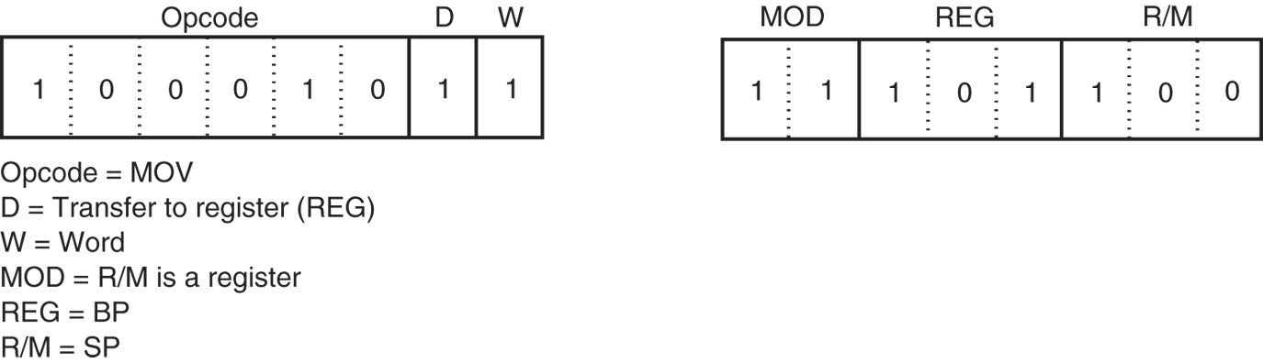
Figure 4–4 The 8BEC instruction placed into bytes 1 and 2 formats from Figures 4–2 and 4–3. This instruction is a MOV BP,SP.
  the opcode is 100010, a MOV instruction
  D and W bits are a logic 1, so a word moves into the destination register specified in the REG field
  REG field contains 101, indicating register BP, so the MOV instruction moves data into register BP

Slide 16
R/M Memory Addressing
If the MOD field contains a 00, 01, or 10, the R/M field takes on a new meaning.
Figure 4–5 illustrates the machine language version of the 16-bit instruction MOV DL, [DI] or instruction (8AI5H).
This instruction is 2 bytes long and has an opcode 100010, D=1 (to REG from R/M), W=0 (byte), MOD=00 (no displacement), REG=010 (DL), and R/M=101 ([DI]).

Slide 17
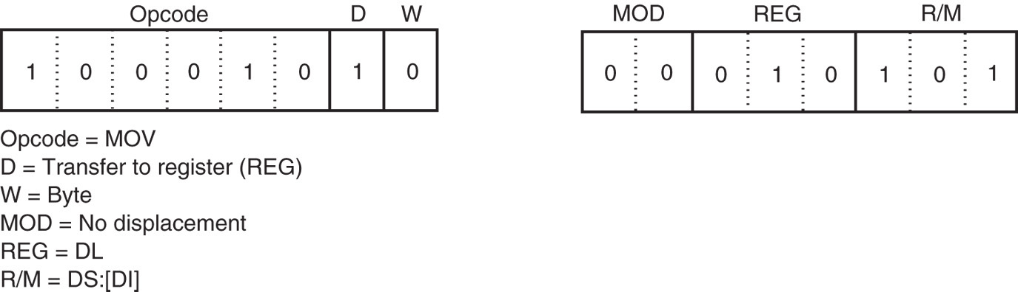
Figure 4–5 A MOV DL,[DI] instruction converted to its machine language form.
  If the instruction changes to MOV DL, [DI+1], the MOD field changes to 01 for 8-bit displacement
  first 2 bytes of the instruction remain the same
  instruction now becomes 8A5501H instead of 8A15H

Slide 18
Because the MOD field contains a 11, the R/M field also indicates a register.
= 100(SP); therefore, this instruction moves data from SP into BP.
  written in symbolic form as a MOV BP,SP instruction
The assembler program keeps track of the register- and address-size prefixes and the mode of operation.

Slide 19
Special Addressing Mode
A special addressing mode occurs when memory data are referenced by only the displacement mode of addressing for 16-bit instructions.
Examples are the MOV [1000H],DL and MOV NUMB,DL instructions.
  first instruction moves contents of register DL
  into data segment memory location 1000H
  second moves register DL into symbolic data segment memory location NUMB

Slide 20
When an instruction has only a displacement, MOD field is always 00; R/M field always 110.
  You cannot actually use addressing mode [BP] without a displacement in machine language
If the individual translating this symbolic instruction into machine language does not know about the special addressing mode, the instruction would incorrectly translate to a MOV [BP], DL instruction.

Slide 21
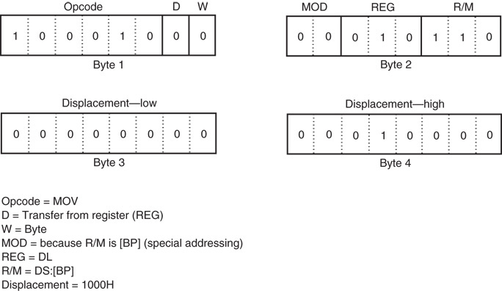
Figure 4–6 The MOV [1000H],DI instruction uses the special addressing mode.
  bit pattern required to encode the MOV [1000H],DL instruction
  in machine language

Slide 22
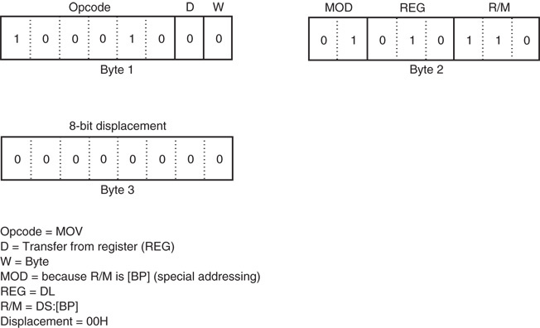
Figure 4–7 The MOV [BP],DL instruction converted to binary machine language.
  actual form of the MOV [BP],DL instruction
  a 3-byte instruction with
  a displacement of 00H

Slide 23
32-Bit Addressing Modes
Found in 80386 and above.
  by running in 32-bit instruction mode or
  In 16-bit mode by using address-size prefix 67H
A scaled-index byte indicates additional forms of scaled-index addressing.
  mainly used when two registers are added to specify the memory address in an instruction
A scaled-index instruction has 2¹⁵ (32K) possible combinations.

Slide 24
Over 32,000 variations of the MOV instruction alone in the 80386 - Core2 microprocessors.
Figure 4–8 shows the format of the scaled-index byte as selected by a value of 100 in the R/M field of an instruction when the 80386 and above use a 32-bit address.
The leftmost 2 bits select a scaling factor (multiplier) of 1x, 2x, 4x, 8x.
Scaled-index addressing can also use a single register multiplied by a scaling factor.

Slide 25
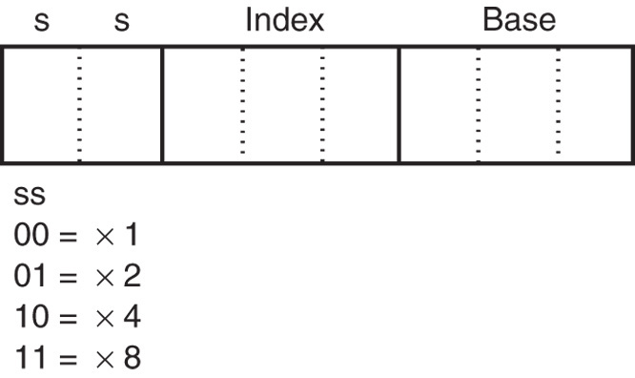
Figure 4–8 The scaled-index byte.
  the index and base fields both contain register numbers

Slide 26
An Immediate Instruction
An example of a 16-bit instruction using immediate addressing.
  MOV WORD PTR [BX+1000H] ,1234H moves a 1234H into a word-sized memory location addressed by sum of 1000H, BX, and DS x 10H
6-byte instruction
  2 bytes for the opcode; 2 bytes are the data of 1234H; 2 bytes are the displacement of 1000H
Figure 4–9 shows the binary bit pattern for each byte of this instruction.

Slide 27
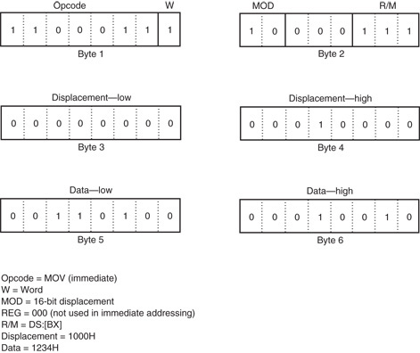
Figure 4–9 A MOV WORD PTR, [BX=1000H] 1234H instruction converted to binary machine language.

Slide 28
This instruction, in symbolic form, includes WORD PTR.
  directive indicates to the assembler that the instruction uses a word-sized memory pointer
If the instruction moves a byte of immediate data, BYTE PTR replaces WORD PTR.
  if a doubleword of immediate data, the DWORD PTR directive replaces BYTE PTR
Instructions referring to memory through a pointer do not need the BYTE PTR, WORD PTR, or DWORD PTR directives.

Slide 29
Segment MOV Instructions
If contents of a segment register are moved by MOV, PUSH, or POP instructions, a special bits (REG field) select the segment register.
  the opcode for this type of MOV instruction is different for the prior MOV instructions
  an immediate segment register MOV is not available in the instruction set
To load a segment register with immediate data, first load another register with the data and move it to a segment register.

Slide 30
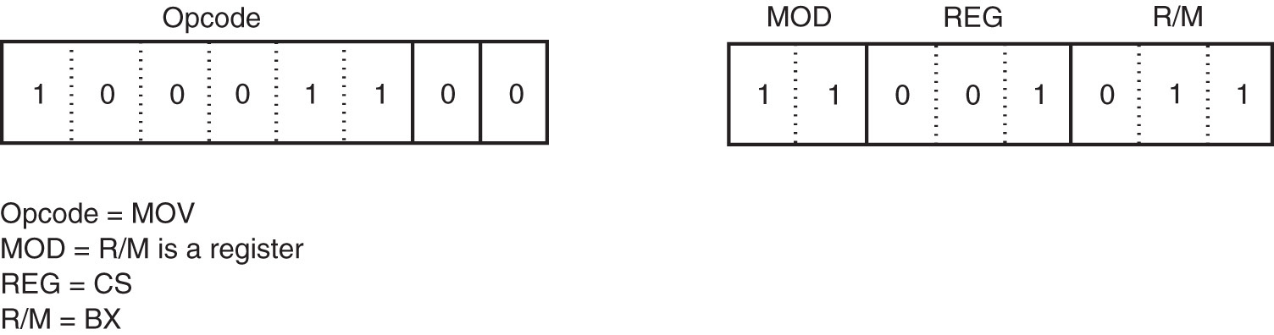
Figure 4–10 A MOV BX,CS instruction converted to binary machine language.
Figure 4–10 shows a MOV BX,CS instruction converted to binary.
Segment registers can be moved between any 16-bit register or 16-bit memory location.

Slide 31
A program written in symbolic assembly language (assembly language) is rarely assembled by hand into binary machine language.
An assembler program converts symbolic assembly language into machine language.

Slide 32
The 64-Bit Mode for the Pentium 4 and Core2
In 64-bit mode, a prefix called REX (register extension) is added.
  encoded as a 40H–4FH, follows other prefixes; placed immediately before the opcode
Purpose is to modify reg and r/m fields in the second byte of the instruction.
  REX is needed to be able to address registers R8 through R15

Slide 33
Figure 4–11 illustrates the structure and application of REX to the second byte of the opcode.
The reg field can only contain register assignments as in other modes of operation
The r/m field contains either a register or memory assignment.
Figure 4–12 shows the scaled-index byte with the REX prefix for more complex addressing modes and also for using a scaling factor in the 64-bit mode of operation.

Slide 34
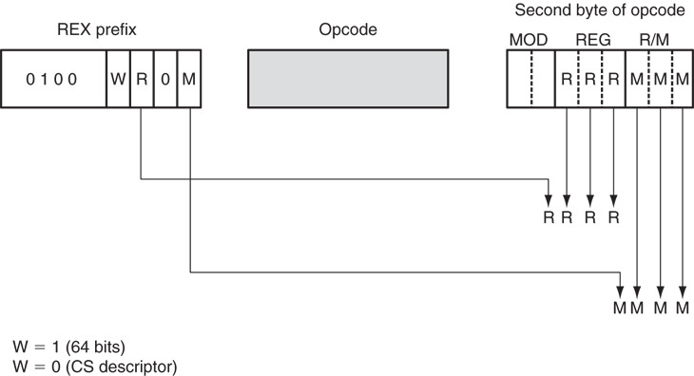
Figure 4–11 The application of REX without scaled index.

Slide 35
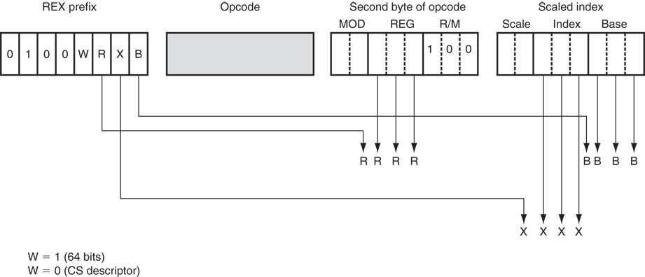
Figure 4–12 The scaled-index byte and REX prefix for 64-bit operations.

Slide 36
4–2 PUSH/POP
Important instructions that store and retrieve data from the LIFO (last-in, first-out) stack memory.
Six forms of the PUSH and POP instructions:
  register, memory, immediate
  segment register, flags, all registers
The PUSH and POP immediate & PUSHA and POPA (all registers) available 80286 - Core2.

Slide 37
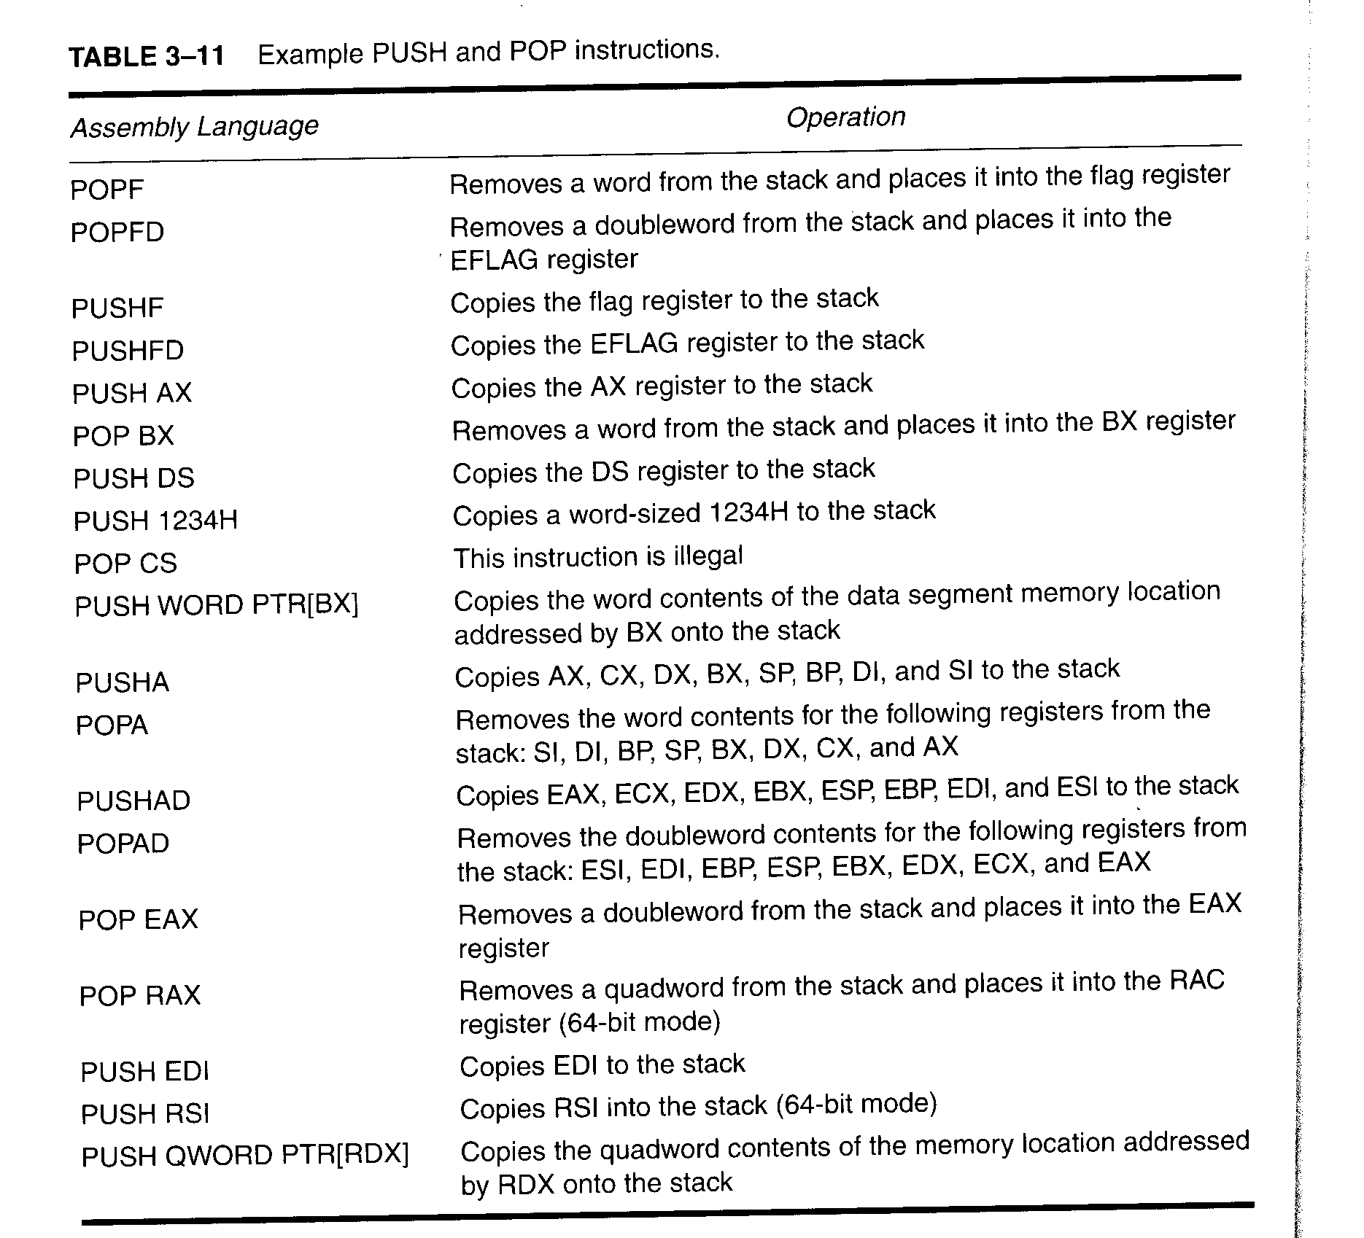
PUSH and POP instructions

Slide 38
Register addressing allows contents of any 16-bit register to transfer to & from the stack.
Memory-addressing PUSH and POP instructions store contents of a 16- or 32 bit memory location on the stack or stack data into a memory location.
Immediate addressing allows immediate data to be pushed onto the stack, but not popped off the stack.

Slide 39
Segment register addressing allows contents of any segment register to be pushed onto the stack or removed from the stack.
  ES may be pushed, but data from the stack may never be popped into ES
The flags may be pushed or popped from
that stack.
  contents of all registers may be pushed or
  popped

Slide 40
PUSH
Always transfers 2 bytes of data to the stack;
  80386 and above transfer 2 or 4 bytes
PUSHA instruction copies contents of the internal register set, except the segment registers, to the stack.
PUSHA (push all) instruction copies the registers to the stack in the following order: AX, CX, DX, BX, SP, BP, SI, and DI.

Slide 41
PUSHF (push flags) instruction copies the contents of the flag register to the stack.
PUSHAD and POPAD instructions push and pop the contents of the 32-bit register set in 80386 - Pentium 4.
  PUSHA and POPA instructions do not function in the 64-bit mode of operation for the Pentium 4

Slide 42
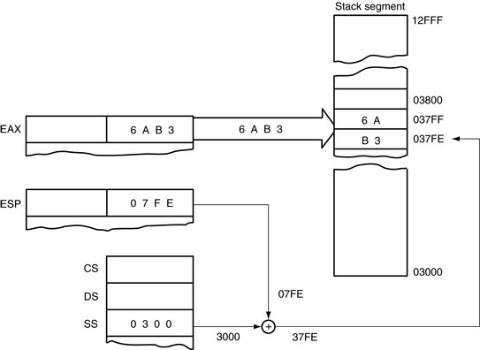
Figure 4–13 The effect of the PUSH AX instruction on ESP and stack memory locations 37FFH and 37FEH. This instruction is shown at the point after execution.

Slide 43
PUSHA instruction pushes all the internal 16-bit registers onto the stack, illustrated in 4–14.
  requires 16 bytes of stack memory space to
  store all eight 16-bit registers
After all registers are pushed, the contents of the SP register are decremented by 16.
PUSHA is very useful when the entire register set of 80286 and above must be saved.
PUSHAD instruction places 32-bit register set on the stack in 80386 - Core2.
  PUSHAD requires 32 bytes of stack storage

Slide 44
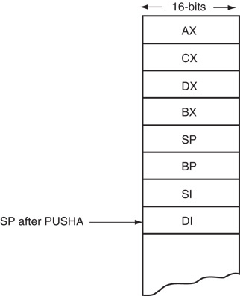
Figure 4–14 The operation of the PUSHA instruction, showing the location and order of stack data.

Slide 45
POP
Performs the inverse operation of PUSH.
POP removes data from the stack and places it in a target 16-bit register, segment register, or a 16-bit memory location.
  not available as an immediate POP
POPF (pop flags) removes a 16-bit number from the stack and places it in the flag register;
  POPFD removes a 32-bit number from the stack and places it into the extended flag register

Slide 46
POPA (pop all) removes 16 bytes of data from the stack and places them into the following registers, in the order shown: DI, SI, BP, SP, BX, DX, CX, and AX.
  reverse order from placement on the stack by PUSHA instruction, causing the same data to return to the same registers
Figure 4–15 shows how the POP BX instruction removes data from the stack and places them into register BX.

Slide 47
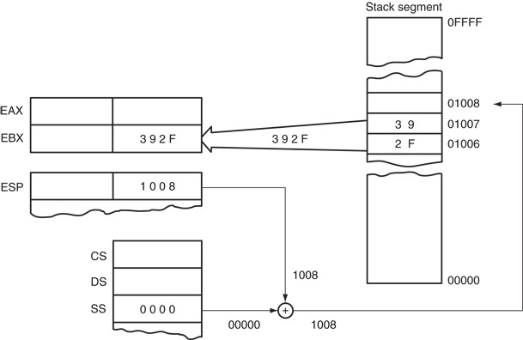
Figure 4–15 The POP BX instruction, showing how data are removed from the stack. This instruction is shown after execution.

Slide 48
Initializing the Stack
When the stack area is initialized, load both the stack segment (SS) register and the stack pointer (SP) register.
Figure 4–16 shows how this value causes data to be pushed onto the top of the stack segment with a PUSH CX instruction.
All segments are cyclic in nature
  the top location of a segment is contiguous
  with the bottom location of the segment

Slide 49
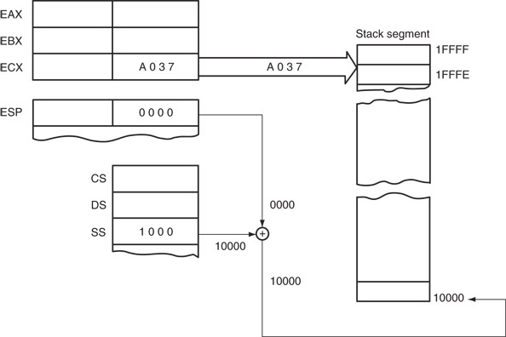
Figure 4–16 The PUSH CX instruction, showing the cyclical nature of the stack segment. This instruction is shown just before execution, to illustrate that the stack bottom is contiguous to the top.

Slide 50
Assembly language stack segment setup:
  first statement identifies start of the segment
  last statement identifies end of the stack segment
Assembler and linker programs place correct stack segment address in SS and the length of the segment (top of the stack) into SP.
There is no need to load these registers in your program.
  unless you wish to change the initial values for some reason

Slide 51
If the stack is not specified, a warning will appear when the program is linked.
Memory section is located in the program segment prefix (PSP), appended to the beginning of each program file.
If you use more memory for the stack, you
will erase information in the PSP.
  information critical to the operation of your program and the computer
Error often causes the program to crash.

Slide 52
LEA
Loads a 16- or 32-bit register with the offset address of the data specified by the operand.
Earlier examples presented by using the OFFSET directive.
  OFFSET performs same function as LEA instruction if the operand is a displacement
LEA and MOV with OFFSET instructions are both the same length (3 bytes).

Slide 53
Why is LEA (LOAD EFFECTIVE ADDRESS ) instruction available if OFFSET accomplishes the same task?
  OFFSET functions with, and is more efficient than LEA instruction, for simple operands such as LIST
  Microprocessor takes longer to execute the LEA BX,LIST instruction the MOV BX,OFFSET LIST
The MOV BX,OFFSET LIST instruction is actually assembled as a move immediate instruction and is more efficient.

Slide 54
4–3 LOAD EFFECTIVE ADDRESS
LEA instruction loads any 16-bit register with the offset address
  determined by the addressing mode selected
LDS and LES load a 16-bit register with offset address retrieved from a memory location
  then load either DS or ES with a segment
  address retrieved from memory
In 80386 and above, LFS, LGS, and LSS are added to the instruction set.

Slide 55
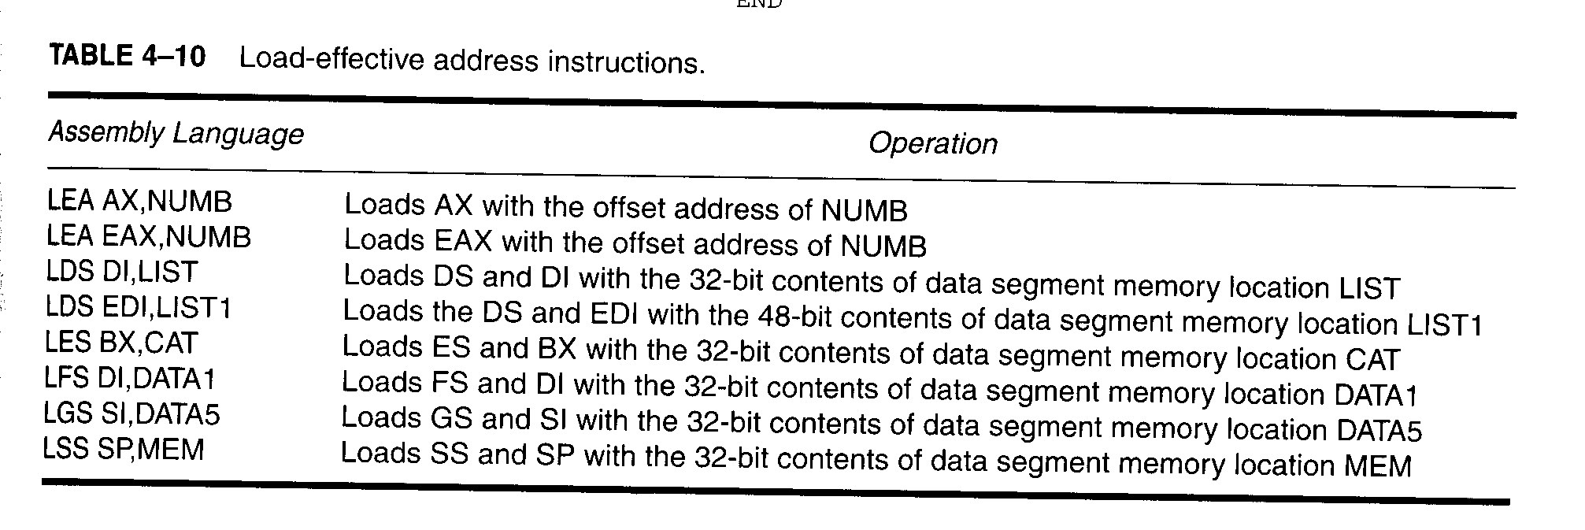
Load-effective address instructions

Slide 56
LDS, LES, LFS, LGS, and LSS
Load any 16- or 32-bit register with an offset address, and the DS, ES, FS, GS, or SS segment register with a segment address.
  instructions use any memory-addressing modes
  to access a 32-bit or 48-bit memory section that contain both segment and offset address
Figure 4–17 illustrates an example LDS BX,[DI] instruction.

Slide 57
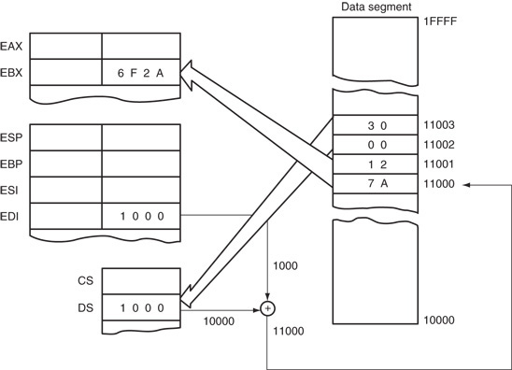
Figure 4–17 The LDS BX,[DI] instruction loads register BX from addresses 11000H and 11001H and register DS from locations 11002H and 11003H. This instruction is shown at the point just before DS changes to 3000H and BX changes to 127AH.

Slide 58
This instruction transfers the 32-bit number, addressed by DI in the data segment, into
the BX and DS registers.
LDS, LES, LFS, LGS, and LSS instructions obtain a new far address from memory.
  offset address appears first, followed by the segment address
This format is used for storing all 32-bit memory addresses.

Slide 59
A far address can be stored in memory by the assembler.
The most useful of the load instructions is the LSS instruction.
  after executing some dummy instructions, the old stack area is reactivated by loading both SS and SP with the LSS instruction
CLI (disable interrupt) and STI (enable interrupt) instructions must be included to disable interrupts.

Slide 60
4–4 STRING DATA TRANSFERS
Five string data transfer instructions: LODS, STOS, MOVS, INS, and OUTS.
Each allows data transfers as a single byte, word, or doubleword.
Before the string instructions are presented, the operation of the D flag-bit (direction), DI, and SI must be understood as they apply to the string instructions.

Slide 61
The Direction Flag
The direction flag (D, located in the flag register) selects the auto-increment or the auto-decrement operation for the DI and SI registers during string operations.
  used only with the string instructions
The CLD instruction clears the D flag and the STD instruction sets it .
  CLD instruction selects the auto-increment mode and STD selects the auto-decrement mode

Slide 62
DI and SI
During execution of string instruction, memory accesses occur through DI and SI registers.
  DI offset address accesses data in the extra segment for all string instructions that use it
  SI offset address accesses data by default
  in the data segment
Operating in 32-bit mode EDI and ESI registers are used in place of DI and SI.
  this allows string using any memory location in
  the entire 4G-byte protected mode address space

Slide 63
LODS
Loads AL, AX, or EAX with data at segment offset address indexed by the SI register.
A 1 is added to or subtracted from SI for a byte-sized LODS
A 2 is added or subtracted for a word-sized LODS.
A 4 is added or subtracted for a doubleword-sized LODS.
Figure 4–18 shows the LODSW instruction.

Slide 64
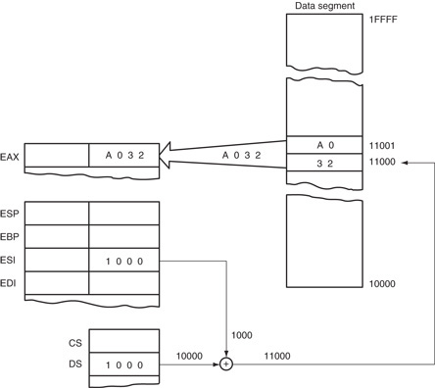
Figure 4–18 The operation of the LODSW instruction if DS=1000H, D=0,11000H, 11001H = A0. This instruction is shown after AX is loaded from memory, but before SI increments by 2.

Slide 65
STOS
Stores AL, AX, or EAX at the extra segment memory location addressed by the DI register.
STOSB (stores a byte) stores the byte in AL at the extra segment memory location addressed by DI.
STOSW (stores a word) stores AX in the memory location addressed by DI.
After the byte (AL), word (AX), or doubleword (EAX) is stored, contents of DI increment or decrement.

Slide 66
STOS with a REP
The repeat prefix (REP) is added to any string data transfer instruction except LODS.
  REP prefix causes CX to decrement by 1 each time the string instruction executes; after CX decrements, the string instruction repeats
If CX reaches a value of 0, the instruction terminates and the program continues.
If CX is loaded with 100 and a REP STOSB instruction executes, the microprocessor automatically repeats the STOSB 100 times.

Slide 67
MOVS
Transfers a byte, word, or doubleword a data segment addressed by SI to extra segment location addressed by SI.
  pointers are incremented or decremented, as dictated by the direction flag
Only the source operand (SI), located in the data segment may be overridden so another segment may be used.
The destination operand (DI) must always be located in the extra segment.

Slide 68
INS
Transfers a byte, word, or doubleword of data from an I/O device into the extra segment memory location addressed by the DI register.
  I/O address is contained in the DX register
Useful for inputting a block of data from an external I/O device directly into the memory.
One application transfers data from a disk drive to memory.
  disk drives are often considered and interfaced
  as I/O devices in a computer system

Slide 69
Three basic forms of the INS.
INSB inputs data from an 8-bit I/O device and stores it in a memory location indexed by SI.
INSW instruction inputs 16-bit I/O data and stores it in a word-sized memory location.
INSD instruction inputs a doubleword.
These instructions can be repeated using the REP prefix
  allows an entire block of input data to be stored
  in the memory from an I/O device

Slide 70
OUTS
Transfers a byte, word, or doubleword of data from the data segment memory location address by SI to an I/O device.
  I/O device addressed by the DX register as with the INS instruction
In the 64-bit mode for Pentium 4 and Core2, there is no 64-bit output
  but the address in RSI is 64 bits wide

Slide 71
4–5 MISCELLANEOUS DATA TRANSFER INSTRUCTIONS
Used in programs, data transfer instructions detailed in this section are XCHG, LAHF, SAHF, XLAT, IN, OUT, BSWAP, MOVSX, MOVZX, and CMOV.

Slide 72
XCHG
Exchanges contents of a register with any other register or memory location.
  cannot exchange segment registers or
  memory-to-memory data
Exchanges are byte-, word-, or doubleword and use any addressing mode except immediate addressing.
XCHG using the 16-bit AX register with another 16-bit register, is most efficient exchange.

Slide 73
LAHF and SAHF
Seldom used bridge instructions.
LAHF instruction transfers the rightmost 8 bits of the flag register into the AH register.
SAHF instruction transfers the AH register into the rightmost 8 bits of the flag register.
SAHF instruction may find some application with the numeric coprocessor.
As legacy instructions, they do not function in the 64-bit mode and are invalid instructions.

Slide 74
XLAT
Converts the contents of the AL register into a number stored in a memory table.
  performs the direct table lookup technique often used to convert one code to another
An XLAT instruction first adds the contents of AL to BX to form a memory address within the data segment.
  copies the contents of this address into AL
  only instruction adding an 8-bit to a 16-bit number

Slide 75
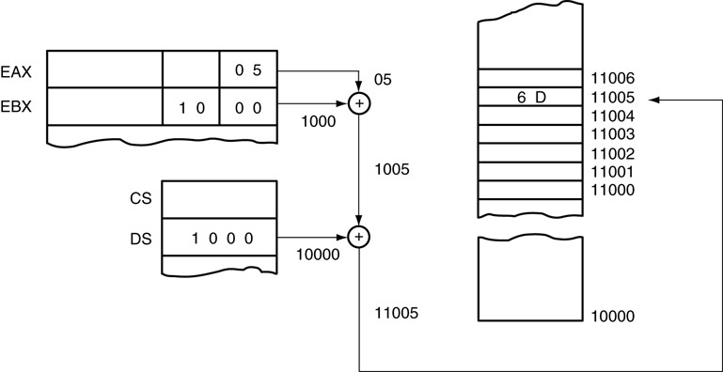
Figure 4–19 The operation of the XLAT instruction at the point just before 6DH is loaded into AL.

Slide 76
IN and OUT
IN & OUT instructions perform I/O operations.
Contents of AL, AX, or EAX are transferred only between I/O device and microprocessor.
  an IN instruction transfers data from an external I/O device into AL, AX, or EAX
  an OUT transfers data from AL, AX, or EAX to an external I/O device
Only the 80386 and above contain EAX

Slide 77
Often, instructions are stored in ROM.
  a fixed-port instruction stored in ROM has its port number permanently fixed because of the nature of read-only memory
A fixed-port address stored in RAM can be modified, but such a modification does not conform to good programming practices.
The port address appears on the address bus during an I/O operation.

Slide 78
Two forms of I/O device (port) addressing:
Fixed-port addressing allows data transfer between AL, AX, or EAX using an 8-bit I/O port address.
  port number follows the instruction’s opcode
Variable-port addressing allows data transfers between AL, AX, or EAX and a 16-bit port address.
  the I/O port number is stored in register DX,
  which can be changed (varied) during the execution of a program.

Slide 79
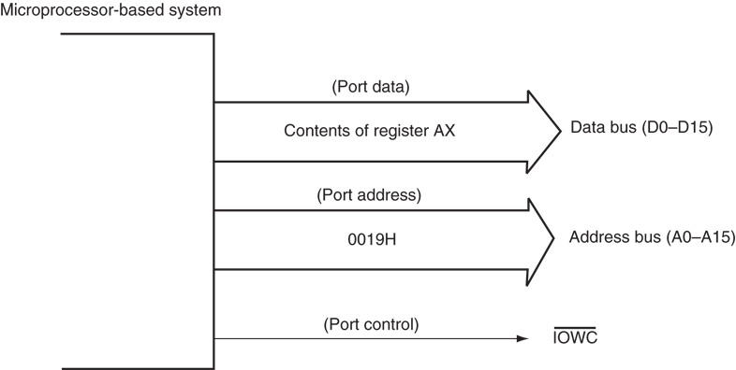
Figure 4–20 The signals found in the microprocessor-based system for an OUT 19H,AX instruction.

Slide 80
BSWAP
Takes the contents of any 32-bit register and swaps the first byte with the fourth, and the second with the third.
  BSWAP (byte swap) is available only in 80486–Pentium 4 microprocessors
This instruction is used to convert data between the big and little endian forms.
In 64-bit operation for the Pentium 4, all 8 bytes in the selected operand are swapped.

Slide 81
CMOV
Many variations of the CMOV instruction.
  these move the data only if the condition is true
CMOVZ instruction moves data only if the result from some prior instruction was a zero.
  destination is limited to only a 16- or 32-bit register, but the source can be a 16- or 32-bit register or memory location
Because this is a new instruction, you cannot use it with the assembler unless the .686 switch is added to the program

Slide 82
4–6 SEGMENT OVERRIDE PREFIX
May be added to almost any instruction in any memory-addressing mode
  allows the programmer to deviate from the
  default segment
  only instructions that cannot be prefixed are jump and call instructions using the code segment register for address generation
  Additional byte appended to the front of an instruction to select alternate segment register

Slide 83
4–7 ASSEMBLER DETAIL
The assembler can be used two ways:
  with models unique to a particular assembler
  with full-segment definitions that allow complete control over the assembly process and are universal to all assemblers
In most cases, the inline assembler found in Visual is used for developing assembly code for use in a program
  occasions require separate assembly modules using the assembler

Slide 84
Directives
Indicate how an operand or section of a program is to be processed by the assembler.
  some generate and store information in the memory; others do not
The DB (define byte) directive stores bytes of data in the memory.
BYTE PTR indicates the size of the data referenced by a pointer or index register.
Complex sections of assembly code are still written using MASM.

Slide 85
Storing Data in a Memory Segment
DB (define byte), DW (define word), and DD (define doubleword) are most often used with MASM to define and store memory data.
If a numeric coprocessor executes software in the system, the DQ (define quadword) and DT (define ten bytes) directives are also common.
These directives label a memory location with a symbolic name and indicate its size.

Slide 86
Memory is reserved for use in the future by using a question mark (?) as an operand for a DB, DW, or DD directive.
  when ? is used in place of a numeric or ASCII value, the assembler sets aside a location and does not initialize it to any specific value
It is important that word-sized data are placed at word boundaries and doubleword-sized data are placed at doubleword boundaries.
  if not, the microprocessor spends additional
  time accessing these data types

Slide 87
ASSUME, EQU, and ORG
Equate directive (EQU) equates a numeric, ASCII, or label to another label.
  equates make a program clearer and simplify debugging
The THIS directive always appears as THIS BYTE, THIS WORD, THIS DWORD, or THIS QWORD.
The assembler can only assign either a byte, word, or doubleword address to a label.

Slide 88
The ORG (origin) statement changes the starting offset address of the data in the data segment to location 300H.
At times, the origin of data or the code must be assigned to an absolute offset address with the ORG statement.
ASSUME tells the assembler what names have been chosen for the code, data, extra, and stack segments.

Slide 89
PROC and ENDP
Indicate start and end of a procedure (subroutine).
  they force structure because the procedure is clearly defined
If structure is to be violated for whatever reason, use the CALLF, CALLN, RETF, and RETN instructions.
Both the PROC and ENDP directives require a label to indicate the name of the procedure.

Slide 90
The PROC directive, which indicates the start of a procedure, must also be followed with a NEAR or FAR.
  A NEAR procedure is one that resides in the same code segment as the program, often considered to be local
  A FAR procedure may reside at any location in the memory system, considered global
The term global denotes a procedure that can be used by any program.
Local defines a procedure that is only used by the current program.

Slide 91
Memory Organization
The assembler uses two basic formats for developing software:
  one method uses models; the other uses full-segment definitions
Memory models are unique to MASM.
The models are easier to use for simple tasks.
The full-segment definitions offer better control over the assembly language task and are recommended for complex programs.

Slide 92
Models
There are many models available to the MASM assembler, ranging from tiny to huge.
Special directives such as @DATA are used to identify various segments.
Models are important with both Microsoft Visual and Borland development systems if assembly language is included with programs.

Slide 93
Full-Segment Definitions
Full-segment definitions are also used with the Borland and Microsoft environments for procedures developed in assembly language.
The names of the segments in this program can be changed to any name.
Always include the group name ‘DATA’, so the Microsoft program CodeView can be used to symbolically debug this software.

Slide 94
To access CodeView, type CV, followed by the file name at the DOS command line; if operating from Programmer’s WorkBench, select Debug under the Run menu.
If the group name is not placed in a program, CodeView can still be used to debug a program, but the program will not be debugged in symbolic form.

Slide 95
SUMMARY
Data movement instructions transfer data between registers, a register and mem-ory, a register and the stack, memory and the stack, the accumulator and I/O, and the flags and the stack.
Memory-to-memory transfers are allowed only with the MOVS instruction.

Slide 96
SUMMARY
(cont.)
Data movement instructions include MOV, PUSH, POP, XCHG, XLAT, IN, OUT, LEA, LOS, LES, LSS, LGS, LFS, LAHF, SAHF, and the following string instruc-tions: LODS, STOS, MOVS, INS, and OUTS.
The first byte of an instruction contains the opcode, which specifies the operation performed by the microprocessor.
The opcode may be preceded by one or more override prefixes.

Slide 97
SUMMARY
(cont.)
The D-bit, located in many instructions, selects the direction of data flow.
The W-bit, found in most instructions, selects the size of the data transfer.
MOD selects the addressing mode of operation for a machine language instruc-tion's R/M field.
A 3-bit binary register code specifies the REG and R/M fields when the MOD = 11.

Slide 98
SUMMARY
(cont.)
The 8-bit registers are AH, AL, BH, BL, CH, CL, DH, and DL.
The l6-bit registers are AX, BX, CX, DX, SP, BP, DI, and SI.
The 32-bit registers are EAX, EBX, ECX, EDX, ESP, EBP, EDI, and ESI.
To access the 64-bit registers, a new prefix is added called the REX prefix that contains a fourth bit.

Slide 99
SUMMARY
(cont.)
By default, all memory-addressing modes address data in the data segment unless BP or EBP addresses memory.
The BP or EBP register addresses data in the stack segment.
The segment registers are addressed only by the MOV, PUSH, or POP instruc-tions.
The instruction may transfer a segment register to a 16-bit register, or vice versa.

Slide 100
SUMMARY
(cont.)
The 80386 through the Pentium 4 include two additional segment registers, FS & GS.
Data are transferred between a register or a memory location and the stack by the PUSH and POP instructions.
Variations of these instructions allow immediate data to be pushed onto the stack, the flags to be transferred between the stack; all 16-bit registers can transferr between the stack and registers.

Slide 101
SUMMARY
(cont.)
Opcodes that transfer data between the stack and the flags are PUSHF and POPF.
Opcodes that transfer all the 16-bit registers between the stack and the registers are PUSHA and POPA.
In 80386 and above, PUSHFD and POPFD transfer the contents of the EFLAGS between the microprocessor and the stack, and PUSHAD and POPAD transfer all the 32-bit registers.

Slide 102
SUMMARY
(cont.)
The PUSHA and POPA in-structions are invalid in the 64-bit mode.
LEA, LDS, and LES instructions load a register or registers with an effective ad-dress.
The LEA instruction loads any 16-bit register with an effective address; LDS and LES load any 16-bit register and either DS or ES with the effective address.

Slide 103
SUMMARY
(cont.)
In 80386 and above, additional instructions include LFS, LGS, and LSS, which load a 16-bit register and FS, GS, or SS.
String data transfer instructions use either or both DI and SI to address memory. .
The DI offset address is located in the extra segment, and the SI offset address is located in the data segment.
If 80386-Core2 operates in protected mode, ESI & EDI are used with string instructions.

Slide 104
SUMMARY
(cont.)
The direction flag (D) chooses the auto-increment or auto-decrement mode of op-eration for DI and SI for string instructions.
To clear D to 0, use the CLD instruction to select the auto-increment mode; to set D to 1, use the STD instruction to select the auto-decrement mode.
Either/both DI and SI increment/decrement by 1 for a byte operation, by 2 for a word operation, and 4 for doubleword operation.

Slide 105
SUMMARY
(cont.)
LODS loads AL, AX, or EAX with data from the memory location addressed by SI; STOS stores AL, AX, or EAX in the memory location addressed by DI; and MOVS transfers a byte, a word, or a doubleword from the memory location addressed by SI into the location addressed by DI.

Slide 106
SUMMARY
(cont.)
INS inputs data from an I/O device addressed by DX and stores it in the memory location addressed by DI.
The OUTS instruction outputs the contents of the memory location addressed by SI and sends it to the I/O device addressed by DX.

Slide 107
SUMMARY
(cont.)
The REP prefix may be attached to any string instruction to repeat it.
The REP prefix repeats the string instruction the number of times found in register CX.
Arithmetic and logic operators can be used in assembly language.
An example is MOV AX,34*3, which loads AX with 102.

Slide 108
SUMMARY
(cont.)
Translate (XLAT) converts the data in AL into a number stored at the memory loca-tion addressed by BX plus AL.
IN and OUT transfer data between AL, AX, or EAX and an external I/O device.
The address of the I/O device is either stored with the instruction (fixed-port addressing) or in register DX (variable-port addressing).

Slide 109
SUMMARY
(cont.)
The Pentium Pro-Core2 contain a new instruction called CMOV, or conditional move.
This instruction only performs the move if the condition is true.
The segment override prefix selects a different segment register for a memory lo-cation than the default segment.

Slide 110
SUMMARY
(cont.)
Assembler directives DB (define byte), DW (define word), DD (define doubleword), and DUP (duplicate) store data in the memory system.
The EQU (equate) directive allows data or labels to be equated to labels.
The SEGMENT directive identifies the start of a memory segment and ENDS iden-tifies the end of a segment when full-segment definitions are in use.

Slide 111
SUMMARY
(cont.)
The ASSUME directive tells the assembler what segment names you have as-signed to CS, DS, ES, and SS when full-segment definitions are in effect.
In the 80386 and above, ASSUME also indicates the segment name for FS and GS.
The PROC and ENDP directives indicate the start and end of a procedure.

Slide 112
SUMMARY
(cont.)
The assembler assumes that software is being developed for the 8086/8088 mi-croprocessor unless the .286, .386, .486, .586, or .686 directive is used to select one of these other microprocessors.
This directive follows the .MODEL statement to use the 16-bit instruction mode and precedes it for the 32-bit instruction mode.

Slide 113
SUMMARY
Memory models can be used to shorten the program slightly, but they can cause problems for larger programs.
Also be aware that memory models are not compatible with all assembler programs.

